Slide 1
Stock Price Prediction and Trading Strategy Analysis
Stock: GOOG

Slide 2
Overview
Assumption
Cleaning
Training
Testing
Result
Assumptions
Modelling
Raw Price
Simplicity
Short-term
Price Movements
Consistency
Macro-level Influence
Residual
Data Leakage
Overfitting
Focus on Predictive Signals
Buy Only Strategy
Sell-Signals
Bear Market
High Rate Environment
Notes:
Raw prices are the actual closing prices on a given day, without any adjustments for stock splits, dividends, or other corporate actions.
By using raw prices, you avoid the need to incorporate additional complexities like adjustments for splits or dividends, making the initial analysis simpler and more focused on price movements.
trading strategy buys and sells based on the predicted direction of price changes, the focus is on short-term price movements rather than long-term total returns
Consistency Across Tickers
For tickers like GOOG and MSFT, using raw prices ensures consistency in comparing price behaviors without needing to normalize for historical corporate events like splits or dividend payouts.
This approach was particularly important for GOOG, given the complexity introduced by its 20:1 split and dual-class share structure. By avoiding adjustments, you simplify the cleaning process.
Macro-level influences, like interest rates and GDP, affect raw prices directly. Using adjusted prices might distort this relationship, as adjusted prices incorporate adjustments that don’t necessarily relate to macroeconomic conditions (e.g., stock splits).
Focus on Predictive Signals
Our trading strategy is based on identifying predictive signals rather than perfecting the residual error structure.
By omitting residuals, we prioritize actionable predictors (e.g., RSI, macro factors, lagged returns) that directly influence buy/sell decisions, aligning more closely with practical trading strategy.

Slide 3
Assumptions
Efficient Market Assumption
Macro-Factors as Predictors
Cross-Stock Relationship (Spillover)
Correlated Investor Behavior
Sector-Specific Dynamics
Lagged Influence
Notes:
The model assumes there are inefficiencies or patterns in the market that can be exploited, despite the Efficient Market Hypothesis (EMH) suggesting all available information is priced in.

Slide 4
Data Overview
Stock
Macroeconomic
Cleaning
Google: GOOG
Microsoft: MSFT
Apple: AAPL
Amazon: AMZN
Netflix: NFLX
Federal Funds Rate
Treasury Yield
GDP
Unemployment
Converted raw date columns into a standard date format
Removed irrelevant columns (TRDSTAT, SHRCLS)
Forward Fill Macro Variables
Inclusion of MSFT as part of FAANG replacement for META.
Notes:
Converted raw date columns into a standard date format.

Slide 5
Google IPO (GOOG: Class A)
Created Class C Shares (GOOG)
20 For 1 Stock Split
2004
2014
2022
2 for 1 Stock Split
Relabeled Class A (GOOGL)
Duplicate entries due to Google's stock split in 2014 (GOOG and GOOGL)
Two step filter GOOGL
Notes:
Google went public through an initial public offering (IPO) in 2004, issuing shares of Class A common stock on the Nasdaq Global Select Market under the symbol "GOOG". The company then split its stock in 2014. That created a new set of Class C shares that began trading on the Nasdaq Global Select Market under the symbol "GOOG," while the company relabeled its Class A shares under the ticker "GOOGL"
In 2015, the company reorganized and created the holding company named Alphabet Inc.
Class C shares with no voting rights, and Class A shares with voting rights. The ticker symbol for Class C shares is GOOG, and the ticker symbol for Class A shares is GOOGL.

Slide 6
Cleaning
Macro Factor Integration
Handling Date Gaps in Data
Created a complete date range and ensured data had all dates by merging with this date range. Forward-filled any missing data (e.g., prices, volumes)
Lagging Variables
Created lagged variables for stock prices (LagPRC), volumes (LagVolume), opening prices (LagOpenPrice), and returns for FAANG tickers
Calculated New Features
Returns
RSI
MA50 & MA200
Dummy Variables
Removed Missing Data
Dropped any remaining NA values after feature creation, ensuring a clean dataset for modeling

Slide 7
Variables
Lagged Technical Indicators:
Oversold​: Indicator for whether GOOG's RSI was in an oversold condition on the previous day
Relative Strength Index (RSI)
Oversold Condition (RSI < 30): Indicates potential upward price movement.
Overbought Condition (RSI > 70): Indicates potential downward price movement.
Volume: Previous day’s trading volume for GOOG
Market Volatility and Trends:
MA50 & MA200: Measures the average stock price over 50 and 200 days to smooth out short-term fluctuations
MA50 > MA200: Indicates a bullish trend
Volatility: Captures days where the absolute daily return exceeds 2%, highlighting significant market swings

Slide 8
Variables
Macroeconomic Factors:
Low Yield Environment: Binary indicator for low-yield environment (10-year Treasury yield < 1.5%)
High Unemployment: Binary indicator for high unemployment (> 6%)
Lagged Returns of Other Stocks:
Apple Return: Lagged return of AAPL.
Amazon Return​: Lagged return of AMZN.
Microsoft Return: Lagged return of MSFT.
Netflix Return: Lagged return of NFLX.

Slide 9
Methodology
Data Split
2011-2020
Training
Testing
2011-01-01 to 2014-12-31
2015-01-01 to 2019-12-31
Building the Model
Key Assumptions
Linear Regression model is trained by identifying patterns and learning the relationships between the independent variables and the target variable
Stationarity: Relationships learned during the training period are valid for the testing period.
No Structural Breaks: Assumes no major economic or market regime changes occurred

Slide 10
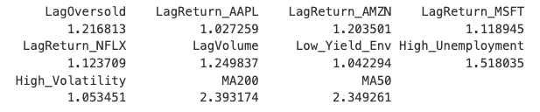
Model Development
Model formula: Linear regression using lagged technical indicators and macro variables.
Low multicollinearity confirmed via Variance Inflation Factor (VIF) values
VIF = 1 No multicollinearity (Ideal)
VIF < 5 Moderate multicollinearity (acceptable)
VIF > 5 High multicollinearity (Problematic)
Notes:
Model formula: Linear regression using lagged technical indicators and macro variables.
VIF used to detect and quantify multicollinearity in a regression model. Multicollinearity occurs when two or more independent variables are highly correlated, leading to unreliable coefficient estimates.

Slide 11
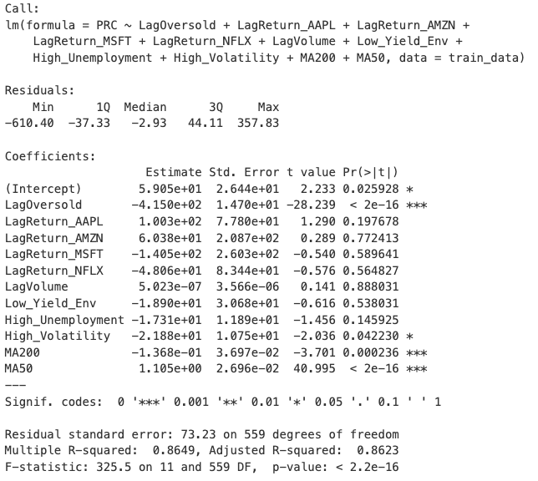
Regression
Residual Standard Error (RSE): 73.23
Indicates the average deviation
R-Squared: 0.8649
Suggests that ~86.49% of the variance in Google's prices is explained by the predictors.
Significance Level

Slide 12
Results

Slide 13
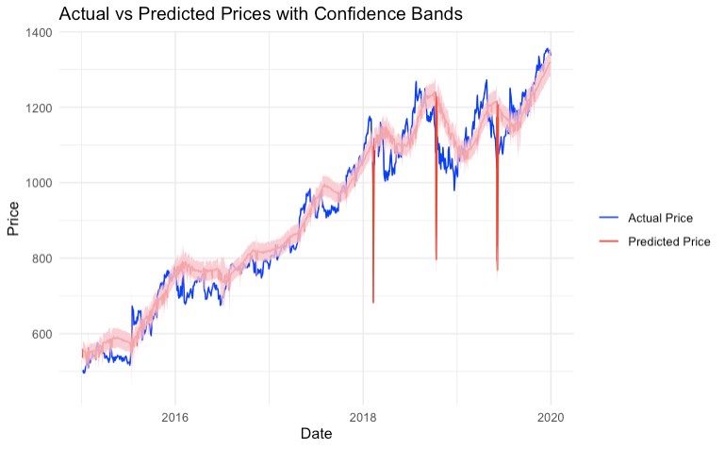
Prediction Results
General Alignment
Confidence Band
Model failed to account for unexpected market events or anomalies
Volatility and Uncertainty
Model performs better under less volatile conditions
Sensitivity to certain inputs
Sudden macroeconomic events not fully captured in the data
A lag in feature response to rapid price changes
Notes:
General Alignment
The predicted prices (red line) generally follow the trend of the actual prices (blue line), indicating that the model captures the overall direction of price movements reasonably well.
2. Prediction Accuracy
The confidence bands (pink shaded area) are relatively narrow for most of the time, suggesting a high level of certainty in the model's predictions.
However, there are instances where the predicted prices deviate significantly from the actual prices (e.g., sharp dips in 2018). These dips highlight periods where the model failed to account for unexpected market events or anomalies.
3. Volatility and Uncertainty
The confidence bands widen slightly during periods of high market volatility (e.g., late 2018), indicating increased uncertainty in predictions.
Narrow bands in stable periods (e.g., 2016) suggest the model performs better under less volatile conditions.
4. Extreme Deviations
The sharp downward spikes in the predicted price indicate potential model overfitting or sensitivity to certain inputs, leading to unrealistic predictions for some days. These could be due to:
Sudden macroeconomic events not fully captured in the data.
A lag in feature response to rapid price changes.
Issues with scaling or residual adjustments.
This was due to massive fine by EU 1.7 Billions failing to provide users with transparent and understandable information on its data use policies. And internal worker turmoil

Slide 14
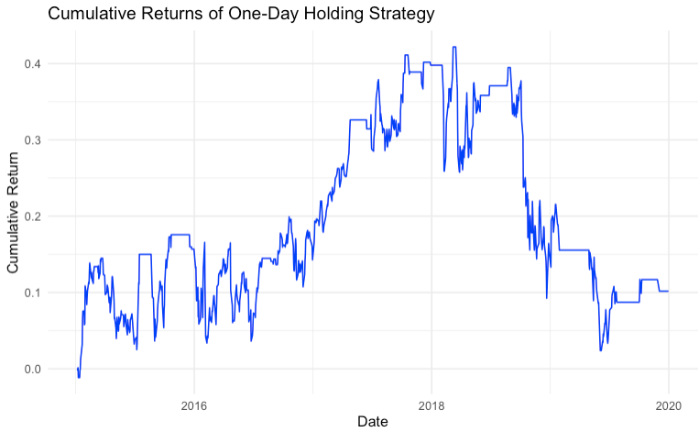
Trading Strategy
Split into Buy or Hold
Intra-day only
Bought at start of trading day and sold at closing
Model only buys if predicted return for the day is positive
Notes:
1. Initial Growth
Between 2015 and 2017, the strategy shows steady growth in cumulative returns, reflecting a period of consistent performance.
This suggests that the model performed well in predicting upward price movements during this time, leading to profitable trades.
2. Peak Performance
The cumulative returns peaked around late 2017 and early 2018, reaching approximately 40% total return.
This indicates that the strategy was particularly effective during this period, potentially capitalizing on favorable market conditions or specific trends in the dataset.
3. Decline in Performance
After the peak, there is a noticeable decline in cumulative returns starting in 2018, with significant drops in mid-2018 and later periods.
This could be due to:
Market volatility or sudden reversals that the model struggled to anticipate.
Structural changes in the market or a shift in the behavior of the asset being modeled.
4. Stabilization and Lower Returns
From 2019 onward, the strategy shows a flatter trajectory, with returns stabilizing at approximately 10-15%.
This indicates reduced profitability in later periods, possibly due to a lack of strong trends or increased noise in the data.
5. Volatility in Returns
The graph shows several sharp dips and recoveries, especially in 2018, highlighting periods of significant losses followed by partial recoveries.
This suggests that the model's predictions may have struggled to consistently handle volatile or uncertain market conditions.

Slide 15
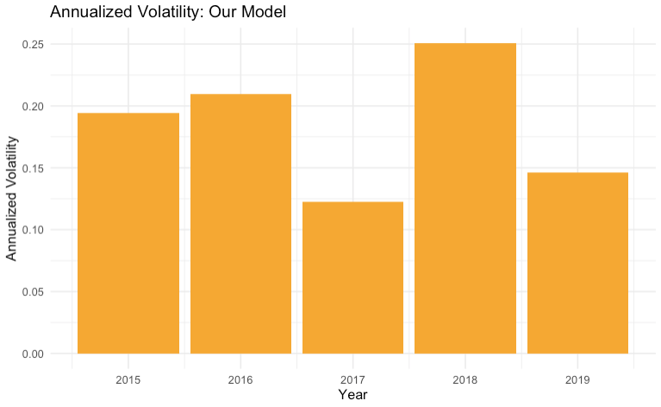
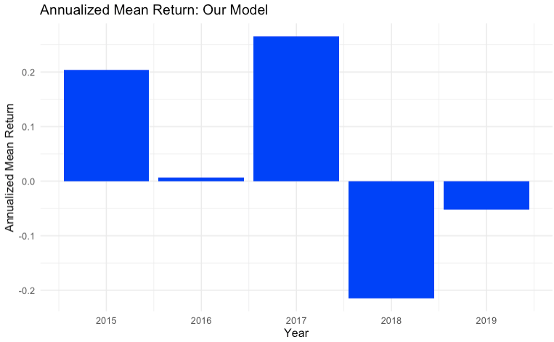
Risk vs. return
Notes:
Sharpe ratio compares the return of an investment with its risk

Slide 16
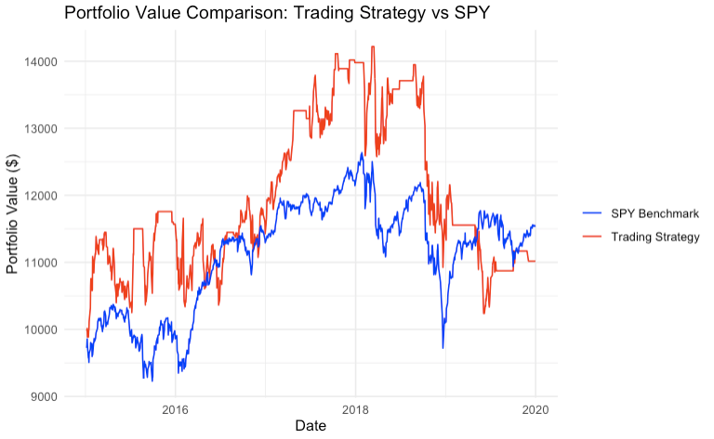
Cumulative Returns Chart for Strategy vs. SPY
Sharpe Ratio (Our Model): 0.2257881
Sharpe Ratio (SPY Benchmark): 0.3199908
Cumulative Return (Our Model): 0.1018455
Cumulative Return (SPY): 0.1533291
Information Ratio (Our Model): 0.08355789
Notes:
Model's excess return (relative to SPY) is slightly positive, meaning trading strategy has outperformed SPY on average—but not by a significant margin.
an IR above 0.5 is considered strong, indicating consistent and meaningful outperformance of the benchmark. An IR close to 0 indicates minimal outperformance relative to the tracking error.

Slide 17
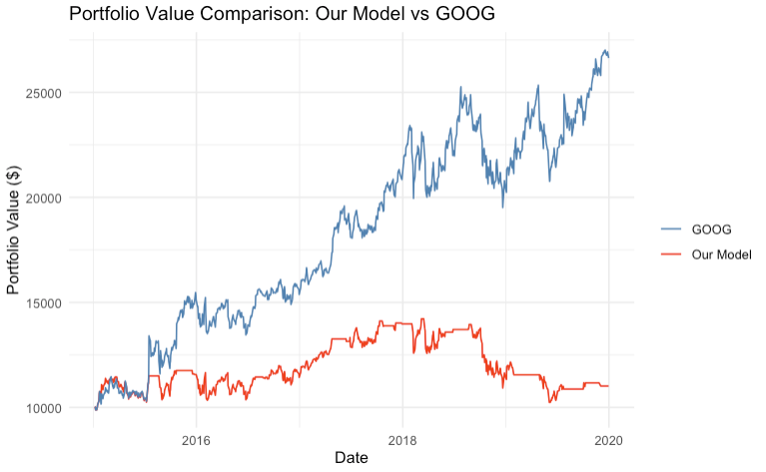
Buy and Hold
Sharpe Ratio (Our Model): 0.2257881
Sharpe Ratio (GOOG): 1.084249
Cumulative Return (Our Model): 0.1018455
Cumulative Return (GOOG): 1.663599
Information Ratio (Our Model vs GOOG): -0.7480226

Slide 18
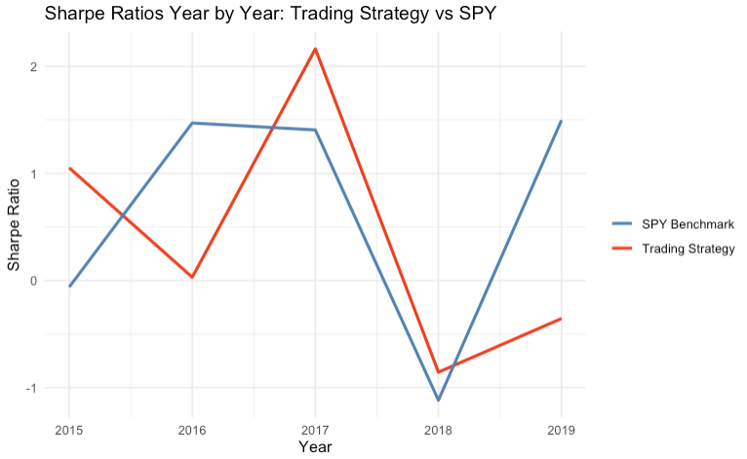
Compared to SPY

Slide 19
Key Takeaways

Slide 20
Key Takeaways
Average individual investor has little chance of beating the market
Only 6% of investment professionals beat the market over a recent 20-year period
Given more data our model would better handle volatility

